Slide 1
Information Security
Ms.Ayesha Jarral
Ayesha.zafar@numl.edu.pk

Slide 2
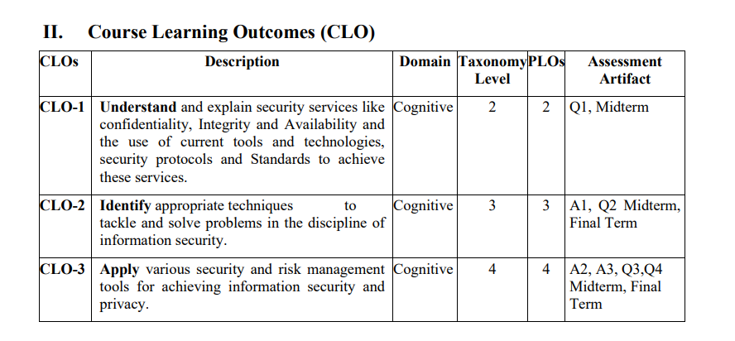
Course Objectives

Slide 3
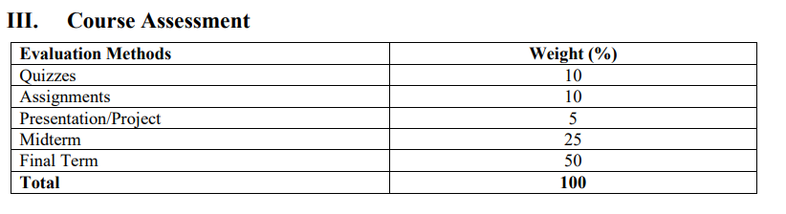
Course Assessments

Slide 4
Books
Stallings, W. (2022). Cryptography and network security: principles and practice. Pearson. ISBN: 9789332585225.
Maymi, F., & Harris, S. (2016). CISSP All-in-One Exam Guide, 7 th Edition. McGraw-Hill Education. ISBN: 9780071849272.

Slide 5
Your Best Strategy
Come to every lectures
Read every lecture after going home and prepare it well.
Do not wait till last minute to prepare for exam or work on projects
Enjoy the fun!

Slide 6
Lectures need your help!
Ask questions
Make suggestions!
Read something interesting and relevant to this course? Announce it in class!

Slide 7
Reader’s Guide
The art of war teaches us to rely not on the likelihood of the enemy's not coming, but on our own readiness to receive him; not on the chance of his not attacking, but rather on the fact that we have made our position unassailable. —The Art of War, Sun Tzu

Slide 8
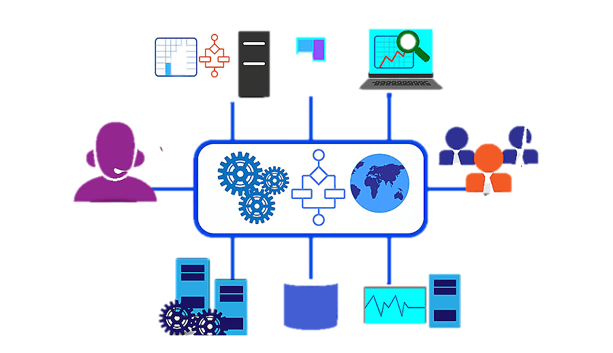
What is information?
Information refers to data that has been processed, organized, structured, or presented in a meaningful context, such that it can be understood, interpreted, and used by individuals or systems.

Slide 9
What is Security?
The quality or state of being secure – to be free from danger.
A successful organization should have multiple layer of security in place:
Physical security
Personal security
Operations security
Communications security
Network security
Information security
Notes:
Here’s a detailed explanation of each security type listed, along with simple examples and incidents to clarify the concepts:
1. Physical Security
Definition: Protection of physical assets like buildings, servers, and equipment from theft, damage, or natural disasters.
Example Incident: A company installs security cameras and locks on server rooms to prevent unauthorized access or theft of sensitive hardware.
Real-Life Scenario: In 2011, hackers broke into Sony’s PlayStation servers. They stole physical access badges, entered the server room, and caused a data breach, compromising millions of accounts.
2. Personal Security
Definition: Ensuring the safety of individuals (employees, executives) against threats such as identity theft, harassment, or kidnapping.
Example Incident: A high-ranking company executive’s personal data is leaked online, leading to identity theft where attackers pose as the executive to gain sensitive information.
Real-Life Scenario: A CEO is targeted by phishing attacks, where criminals tried to access their bank account using personal identification stolen during an online breach.
3. Operations Security (OPSEC)
Definition: Protecting sensitive operational data, such as internal processes and procedures, to prevent it from falling into the wrong hands.
Example Incident: A business hides its product development plans by encrypting emails and using secure file-sharing platforms to avoid leaks during a merger.
Real-Life Scenario: During a military operation, the location of troops is accidentally disclosed due to weak operational security, putting soldiers at risk.
4. Communications Security (COMSEC)
Definition: Securing all communications, both digital and physical, to ensure the confidentiality and integrity of information being transmitted.
Example Incident: An employee uses encrypted email services to send sensitive financial reports, ensuring only authorized personnel can access the information.
Real-Life Scenario: During World War II, the Enigma code used by German forces was cracked by the Allies, allowing them to intercept and decode military communications, which impacted war strategy.
5. Network Security
Definition: Safeguarding the organization’s computer networks from unauthorized access, attacks, or disruptions.
Example Incident: A company's IT team uses firewalls and intrusion detection systems to prevent hackers from launching a Distributed Denial of Service (DDoS) attack on their website.
Real-Life Scenario: In 2020, a massive Twitter hack occurred where attackers accessed internal Twitter systems to send out phishing emails, eventually taking over high-profile accounts like Elon Musk's.
6. Information Security (InfoSec)
Definition: Protecting data, whether stored digitally or physically, from unauthorized access or damage.
Example Incident: An organization uses strong passwords and multi-factor authentication to ensure only authorized users can access sensitive business documents.
Real-Life Scenario: In the Equifax data breach of 2017, hackers exploited a vulnerability in the system, accessing the personal data of 147 million people, leading to a huge information security breach.
Summary Table:
Security TypeDefinitionExample IncidentPhysical SecurityProtecting physical assets like servers and equipment.Installing security cameras to prevent unauthorized access to the server room.
Personal SecurityEnsuring the safety of individuals.CEO's personal data is stolen, leading to identity theft
.Operations SecuritySecuring sensitive operational processes and procedures.Encrypting product development plans to prevent leaks during a merger.
Communications SecuritySecuring all types of communications to prevent unauthorized access.Using encrypted email services to ensure sensitive communications are protected.
Network SecurityProtecting computer networks from unauthorized access or attacks.Implementing firewalls to block hackers from launching a DDoS attack
.Information SecuritySafeguarding data from unauthorized access or modification.Implementing multi-factor authentication to secure sensitive business documents.

Slide 10
What is Information Security?
The protection of information and its critical elements including systems and hardware that use, store, and transmit that information.

Slide 11
Critical Characteristics of Information
The value of information comes from the characteristics it comes:
Availability:
Availability ensures that information is accessible and usable when needed by authorized users.
Accuracy:
Accuracy refers to the correctness and precision of information. Accurate information is free from errors, omissions, or distortions and reflects the true state of affairs.
Authenticity:
Authenticity verifies the origin and trustworthiness of information.
Notes:
Availability:
Availability ensures that information is accessible and usable when needed by authorized users. It involves measures to prevent or mitigate disruptions that could impact access to information, such as system failures, network outages, or cyber attacks.
Accuracy:
Accuracy refers to the correctness and precision of information. Accurate information is free from errors, omissions, or distortions and reflects the true state of affairs. It is essential for making informed decisions and avoiding misunderstandings or misinterpretations.
Authenticity:
Authenticity verifies the origin and trustworthiness of information. Authentic information is genuine and can be traced back to a reliable and verifiable source. It ensures that information has not been tampered with or falsified and can be trusted for its credibility.

Slide 12
Critical Characteristics of Information
4. Confidentiality:
Confidentiality protects sensitive information from unauthorized access, disclosure, or exposure.
5. Integrity:
Integrity ensures the accuracy and reliability of information by protecting it from unauthorized alteration or corruption.
6. Utility:
Utility refers to the usefulness and relevance of information to meet specific needs or objectives.
7. Possession:
Possession refers to the control and ownership of information.
Notes:
4. Confidentiality:
Confidentiality protects sensitive information from unauthorized access, disclosure, or exposure. It ensures that only authorized individuals or entities have access to certain data or resources, safeguarding privacy and preventing unauthorized use or exploitation.
5. Integrity:
Integrity ensures the accuracy and reliability of information by protecting it from unauthorized alteration or corruption. It involves measures to detect and prevent unauthorized changes to data, ensuring that information remains complete, unaltered, and trustworthy.
6. Utility:
Utility refers to the usefulness and relevance of information to meet specific needs or objectives. Useful information provides value and serves a purpose, whether it's for decision-making, problem-solving, or achieving organizational goals. It should be relevant, timely, and actionable.
7. Possession:
Possession refers to the control and ownership of information. It ensures that authorized individuals or entities have the rights and privileges to access, use, or manipulate information as needed. Possession also entails responsibilities for protecting and managing information assets effectively.

Slide 13
Subsets of Information Security
Cyber Security - Cybersecurity is the practice of protecting systems, networks, and programs from digital attacks.
Computer Security - generic name for the collection of tools designed to protect data and to thwart hackers
Network Security - measures to protect data during their transmission
Internet Security - measures to protect data during their transmission over a collection of interconnected networks

Slide 14
CNSS Security Model
CNSS (Committee on National Security Systems is a three-dimensional security model which has now become a standard security model for many of the currently operating information systems.
The CNSS model has three key goals of security: Confidentiality, Integrity, and Availability. This comprises one dimension.
The CNSS model has three information states: Transmission, Storage, Processing. This comprises one dimension.
The CNSS model has three security measures to adopt: Education Training Awareness, Technology, and Policy & Practices.

Slide 15
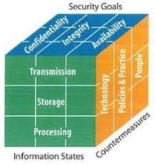
CNSS Security Model
To develop a secure system one must consider not only key security goals (CIA) but also have these goals relate to various states in which information resides and full range of available security measures.
Notes:
1. Three Key Goals of Security: Confidentiality, Integrity, and Availability (CIA Triad)
These are the fundamental objectives of information security, often referred to as the CIA triad:
Confidentiality: Protecting information from unauthorized access.
Example: Imagine your bank account details. Confidentiality ensures that only you and authorized personnel can access your account, not hackers. Encryption and passwords help maintain confidentiality.
Integrity: Ensuring the accuracy and completeness of data.
Example: When sending an email, integrity ensures that the message you send is the exact one received by the recipient, without any changes or corruption.
Availability: Ensuring that information is accessible to authorized users when needed.
Example: A website of a hospital must be available 24/7 for patients and doctors to access medical records or book appointments. Backup systems and redundant servers ensure availability.
2. Three Information States: Transmission, Storage, Processing
This dimension focuses on when and where information can be vulnerable:
Transmission: When data is being sent from one place to another.
Example: Sending a message via WhatsApp is an example of data in transmission. Encryption during transmission ensures that the message can't be intercepted by unauthorized individuals.
Storage: When data is at rest in storage devices.
Example: Your photos saved on a hard drive are data in storage. Proper security measures, like file encryption or access controls, protect this data from unauthorized access.
Processing: When data is being used or manipulated.
Example: During online banking, when you input your password and your bank processes the information to verify your identity, this is data in processing. Security is needed to ensure that no one can tamper with or view this data during the verification process.
3. Three Security Measures: Education Training Awareness, Technology, and Policy & Practices
This dimension represents the strategies used to implement security:
Education Training Awareness: Ensuring that users and employees are aware of security threats and how to avoid them.
Example: A company can hold a workshop on phishing emails, teaching employees to identify suspicious emails and avoid clicking on harmful links.
Technology: Using technical tools to protect data, like firewalls, encryption, and antivirus software.
Example: Antivirus software installed on a computer helps detect and remove viruses, protecting the system from malware attacks.
Policy & Practices: Establishing formal rules and procedures to enforce security.
Example: A company might enforce a policy that requires all employees to change their passwords every 3 months, ensuring password security over time.
Summary of the CNSS Model:
The CNSS model covers all critical aspects of information security:
What to protect: Confidentiality, Integrity, and Availability (CIA triad).
Where and when to protect: During Transmission, Storage, and Processing.
How to protect: Through Education, Technology, and Policies.
By focusing on these three dimensions, organizations can ensure a comprehensive approach to security.

Slide 16
CNSS Security Model
Different groups within an organization may be responsible for data in each of the various states.
For example, the network security group is responsible for data during transmission.
Programmers and data entry people are responsible for data during processing.

Slide 17
Aspects of Information Security
Consider 3 aspects of information security
Security Attack
Security Service
Security Mechanism

Slide 18
Security Attacks
Any action that compromises the security of information owned by an organization
Information Security is about how to prevent attacks, or failing that, to detect attacks on information-based systems
Often threat & attack used to mean same thing have a wide range of attacks
can focus of generic types of attacks
passive
active

Slide 19
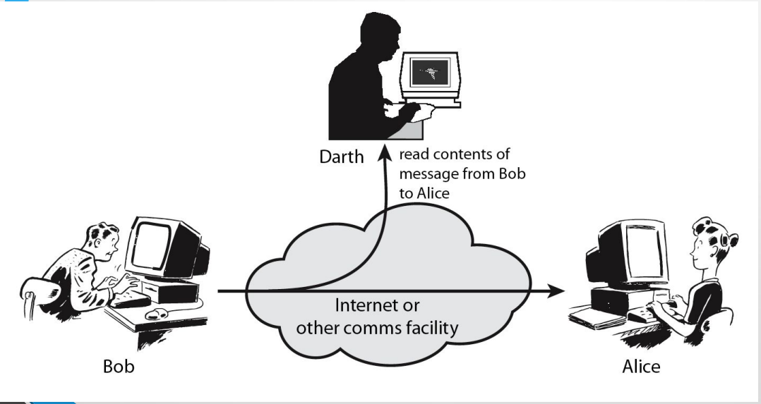
Passive Attack

Slide 20
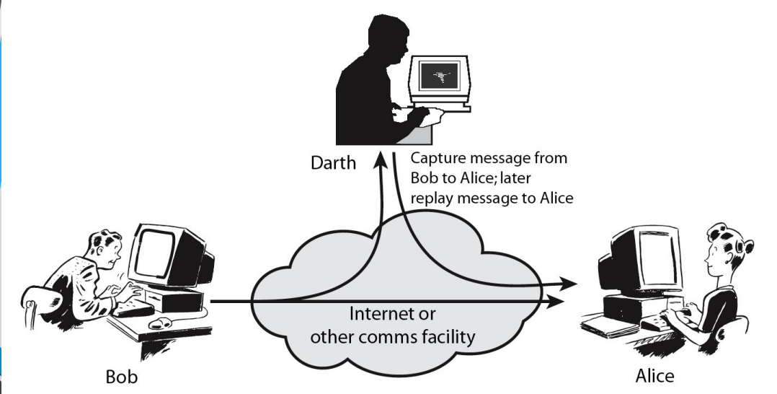
Active Attack

Slide 21
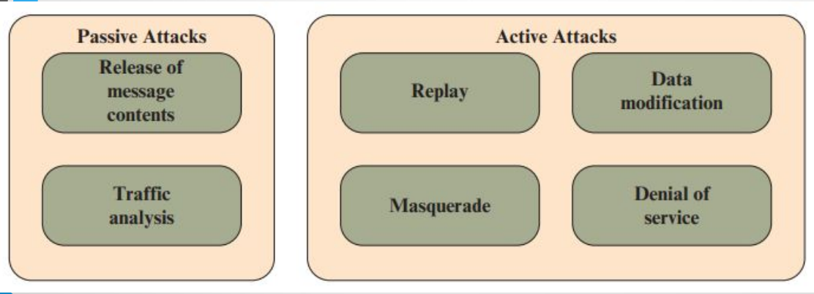
Types of Attacks

Slide 22
Security Service
Enhance security of data processing systems and information transfers of an organization
intended to counter security attacks
using one or more security mechanisms
often replicates functions normally associated with physical documents
for example, have signatures, dates; need protection from disclosure, tampering, or destruction; be notarized or witnessed; be recorded or licensed

Slide 23
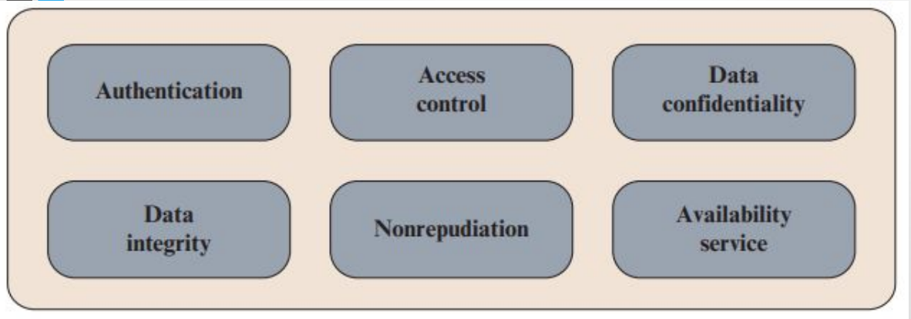
Security Services

Slide 24
Security Services
Authentication - assurance that the communicating entity is the one claimed
Access Control - prevention of the unauthorized use of a resource
Data Confidentiality –protection of data from unauthorized disclosure
Data Integrity - assurance that data received is as sent by an authorized entity
Non-Repudiation - protection against denial by one of the parties in a communication

Slide 25
Security Mechanism
feature designed to detect, prevent, or recover from a security attack
no single mechanism that will support all services required
however one particular element underlies many of the security mechanisms in use:
cryptographic techniques

Slide 26
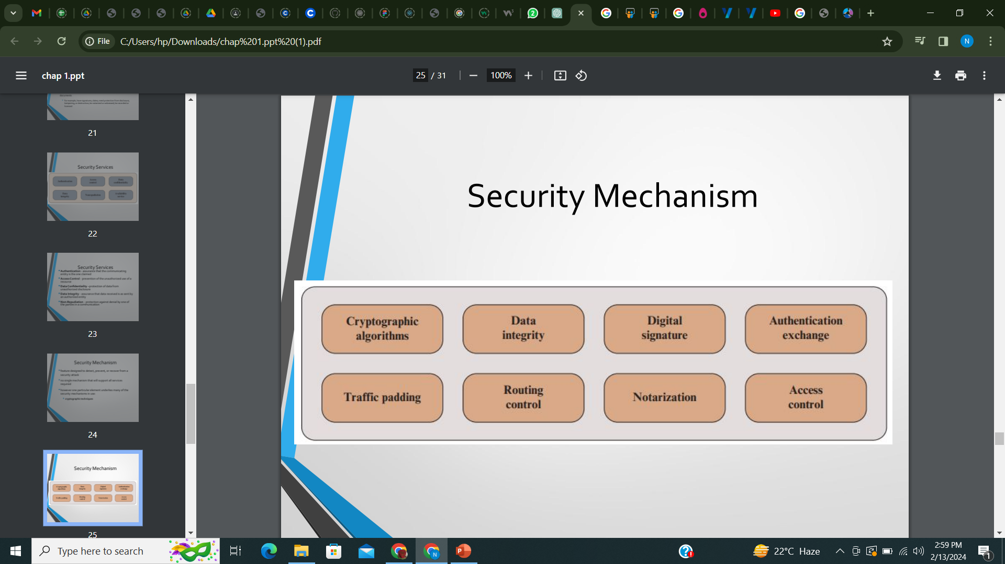
Security Mechanisms

Slide 27
Security Mechanisms
Specific security mechanisms:
A process (or a device compilation such a process) that is designed to identify, avoid, or restore from a security attack.
For example, encipherment, digital signatures, access controls, data integrity, authentication exchange, traffic padding, routing control, notarization
2. Pervasive security mechanisms:
Pervasive Security or Passive Security mechanisms are those which cannot be specific to particular services and are in general directly related to the level of security required.
For example, trusted functionality, security labels, event detection, security audit trails, security recovery

Slide 28
Thank you!

